Slide 1

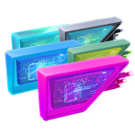
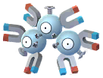
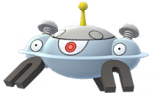
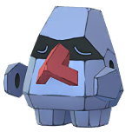
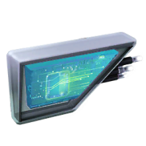
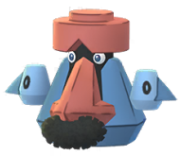
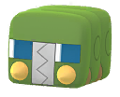
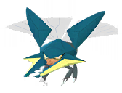
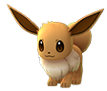
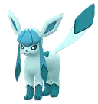
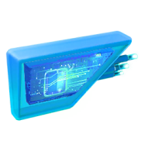
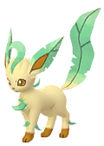
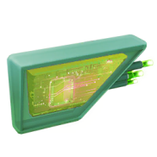

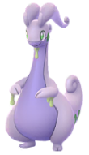
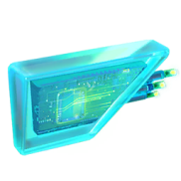
Pokemon Go
Lure Module Evolve Chart Information
Magnetic Lure Module
+ Candy Pokemon
Magneton
100 Candy’s
Magnezone
Nosepass
50 Candy’s
Probopass
Charjabug
100 Candy’s
Vikavolt
Glacial Lure Module
+ Candy Pokemon
Eevee
25 Candy’s
Glaceon
Mossy Lure Module
+ Candy Pokemon
Eevee
25 Candy’s
Leafeon
Rainy Lure Module
+ Candy Pokemon
Sliggoo
100 Candy’s
Goodra
Page 1 of 1

